Slide 1
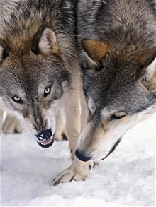
Law of Life by Jack London

Slide 2
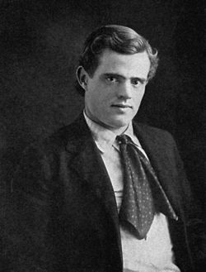
Jack London
Author and journalist from California
Lived in Alaska for a year when he was in his 20s during the Klondike Gold Rush
Most known for The Call of the Wild
Believed in giving up material goods for adventure and natural pleasures

Slide 3
Conflict
Internal- a conflict between opposing forces within a character
External- a conflict between a character and an outside force
Common types of conflict:
Man against man
Man against society
Man against nature
Man against self

Slide 4
POV
1st person: “Wow,” I thought as I stared at the empty shelf in front of me. “I can’t believe all the Oreos are gone.”
2nd person: You walk into a grocery store to buy Oreos. When you get to the shelf, however, you realize with sudden horror that Food Lion is all out of delicious cookie product.

Slide 5
POV Continued
3rd person limited: The woman in red looked sad as she peered at the empty shelf where the Oreos should have been. “I knew I should have gone to the good grocery store,” she thought angrily. A man appeared a few minutes later. The woman thought he looked a bit grumpy, too.
3rd person omniscient: The woman began to wonder if this new stranger might know where she could buy Oreos. The man was too busy thinking about Famous Amos cookies to notice the woman’s distress.

Slide 6
Video
https://www.youtube.com/watch?v=PzB-hFp3anU
Predictions:
What do you think the people in the story will be like?
What is the main problem in the story?
What is the law of life?

Slide 7
Background
Nomadic Life Tribes living in Koskoosh’s area of Alaska were part of a larger group of Native Americans called Athabascans. Some Athabascans fished for salmon for food, while others hunted large animals, especially caribou. Their way of life was to follow migrating herds in winter, setting up and then quickly striking camps as necessary to keep up with the herds. In summer many Athabascan peoples set up fishing camps on rivers and lakes and briefly lived a more settled life.

Slide 8
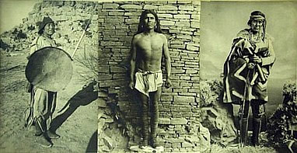

Slide 9
Directions
We’re making a book!
While we read, we will keep track of the story’s progress in a book foldable. Each page will have a summary (which will be provided for you) and an illustration (completed by you using color pencils).

Slide 10
Title Page (1)
The Law of Life
By Jack London and (your name)
Draw a picture of what you think the story is going to be about.

Slide 11
Beginning (Page 2)
An old man, Koskoosh, is lying abandoned in the snow listening to his tribe leaving.

Slide 12
Page 3
After a visit from his son, Koskoosh begins to think seriously about his death.

Slide 13
Page 4
The law of life becomes clear. All things must die.

Slide 14
Page 5
Koskoosh remembers when he was leader of his tribe and left his own father in the snow. He witnessed a great famine.

Slide 15
Page 6
He remembers watching wolves hunt moose when he was very young. The hunt was brutal.

Slide 16
Page 7
Koskoosh reminisces about his youth. He begins to feel conflicted about death.

Slide 17
Page 8
He sees the moose from his youth. Wolves begin to approach. This is the end.

Slide 18
Summary
This short story opens with the blind, aged former leader of an Alaskan tribe listening to the sounds of his tribe departing for new hunting grounds. The old man knows he will be left behind and bids his son a ritual but loving farewell. As he awaits death in the snow, he recalls moments from his youth and considers the inevitable end of all living things. Finally, his fire goes out and a ring of wolves prepares to attack.

Slide 19
Activities
Graphic organizer
Questions 1-3 and 5-7 on page 777

Slide 20
Additional Activities
What are your laws of life? Make a list of the rules of the world.

