Slide 1
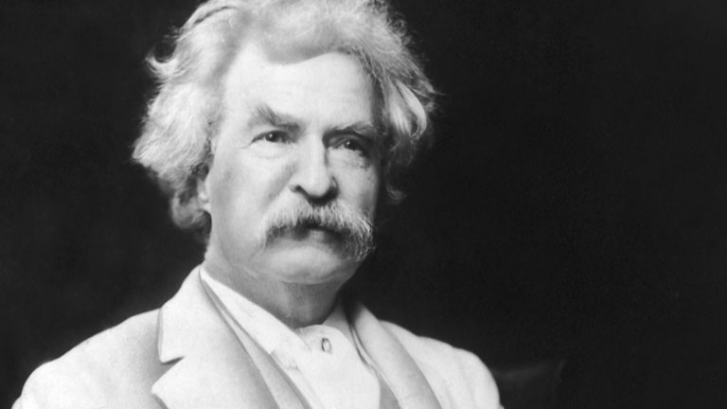
Mark Twain: Life on the Mississippi

Slide 2
Journal
In your notebooks, answer this prompt with at least ½ page:
Is ignorance bliss? Are you happier when you don’t know the truth? Would you rather know the truth and be upset or know a lie and be happy?

Slide 3
Mark Twain
Incredibly famous and influential
Frequently quoted because of his intelligent and funny outlook on life
Ex. “To succeed in life, you need two things: ignorance and confidence.”
Real name is Samuel Clemens
Grew up in Missouri & worked as a riverboat pilot
Writes primarily about life on the Mississippi River and the frontier
Local color writer (uses lots of dialect)

Slide 4
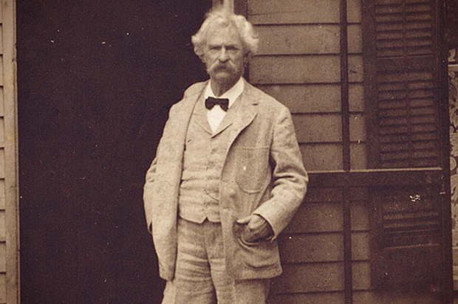

Slide 5
Terms to Know
Voice: a writer’s unique use of language that allows a reader to “hear” a human personality in his or her writing
Diction: a writer’s choice of words
Tone: a writer’s attitude toward his or her subject
Paraphrasing: writing information from another source in your own words

Slide 6
Activity
Your graphic organizer has 10 words from today’s story. You will walk around the room and record each word’s definition in the definition box.
Afterwards, you will find the word in the story, and write down the sentence it comes from in the box labeled “sentence from story.”
3. After we go over the words, you will write an example sentence with each word in the “write your own” box.

Slide 7
Life on the Mississippi
Excerpt from Twain’s memoir
Tells the story of his first days at his new job as a riverboat pilot
https://www.youtube.com/watch?v=t3bOWyTBbQA

Slide 8
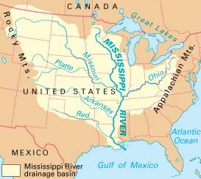

Slide 9
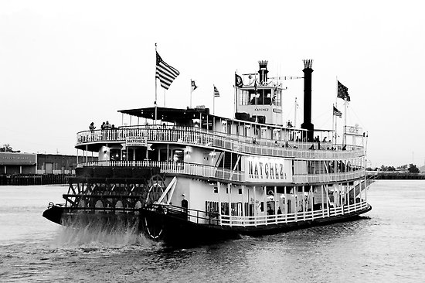
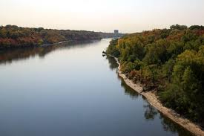

Slide 10
Read
Read “Life on the Mississippi” on page 674
While we read, we are going to complete a summarizing/drawing activity.
In one box, you are going to draw a picture of something that happened in that section.
In the box beside, you are going to write a summary of that section in your own words.
In the small box, you are going to write at three words from that section that you did not know or that grabbed your attention.

Slide 11
After Reading
Complete the paraphrasing worksheet
If you finish the worksheet, answer questions 6 and 7 on page 682

