Slide 1
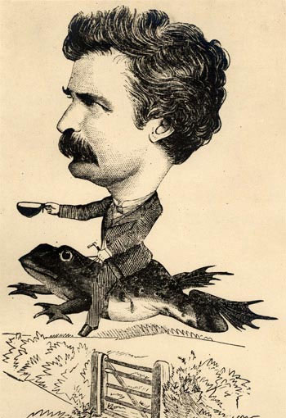
The Notorious Jumping Frog of Calaveras County by Mark Twain

Slide 2
Journal
What’s the funniest story you know? Did it happen to you or someone else? Where did it happen? Why was it so funny?

Slide 3
Terms to Know
Tall tale- A distinctively American type of humorous story characterized by exaggeration
Hyperbole- A figure of speech in which the truth is exaggerated for emphasis or humorous effect
Understatement- A technique of saying less than is actually or literally true

Slide 4
2 Truths and a Lie
In your notebook, write down your 2 truths and lie. (Please keep them school appropriate.)
What makes a lie funny? What makes it believable?

Slide 5
Tall Tale Example
Sally Britches was taller than a redwood. Why, when she was born, her ma was sorter surprised-like to see that her baby gal was too big fer young’un clothes. “Oh, well,” sighed her ma. “I guess you kin jist wear yer pa’s ole britches.”
Find hyperbole, understatement, and dialect.

Slide 6
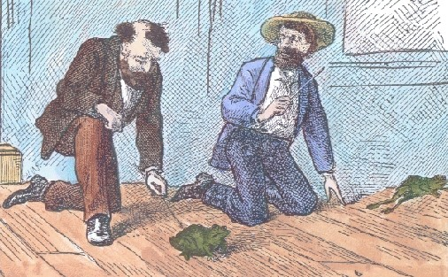
Video
https://www.youtube.com/watch?v=FXivgpLSQeo.

Slide 7
Reading Check 1
Reread lines 21-23 on page 686. What words help you figure out the meaning of monotonous?

Slide 8
Reading Check 2
Reread lines 57-67 on page 687. What is Wheeler saying?

Slide 9
Reading Check 3
Reread lines 120-138 on page 689. What is the understatement? What does this say about the characters?

Slide 10
Summary
The narrator of this tall tale locates Simon Wheeler in a mining camp and asks if he knows Leonidas W. Smiley. Wheeler does not, but launches into a reminiscence about Jim Smiley, who would bet on anything. Wheeler tells how Smiley once engaged a stranger in a frog jumping contest. The stranger tricked Smiley by making Smiley’s frog swallow quail shot so that it was too heavy to jump. The narrator makes his escape just as Wheeler launches into another story.

Slide 11
Activities
Quiz
Vocabulary worksheet and definitions
Answer question 5-7 on page 691

Slide 12
Additional Activity
If time allows, write your own tall tale. In ½ to 1 page, tell a funny story with understatement and exaggeration.

