Slide 1
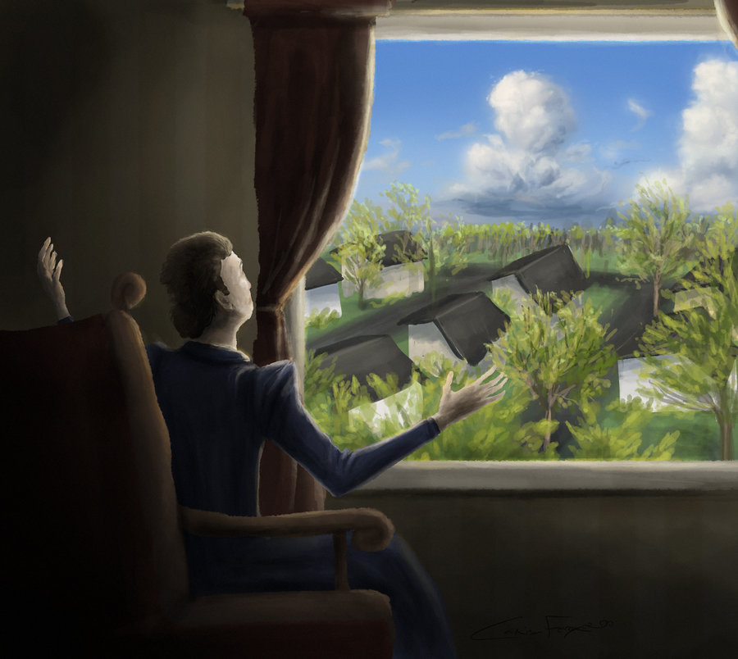
The Story of an Hour by Kate Chopin

Slide 2
Journal
Have you ever felt trapped/restricted/oppressed by something? Explain and provide an example if possible.

Slide 3
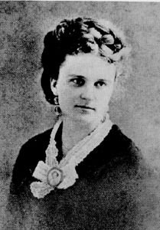
Background Info
Kate Chopin is a famous female writer
Known for her local color writing regarding women in Louisiana
Most famous for The Awakening
Like Gilman, she wrote about the domestic oppression of women

Slide 4
Terms to Know
Active Voice: when the subject performs the action
Ex. The student broke the colored pencils.
Passive Voice: when the object is the subject and has the action performed to/on it
Ex. The colored pencils were broken by the student.

Slide 5
Close Reading Activity
We will read “The Story of an Hour” together and look for examples of active and passive voice.
Afterwards, the text will be used to complete different activities around the room. Each activity will have a corresponding box on your worksheet which will be turned it at the end of class.

