Slide 1
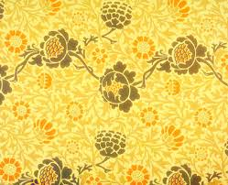
The Yellow Wallpaper by Charlotte Perkins Gilman

Slide 2
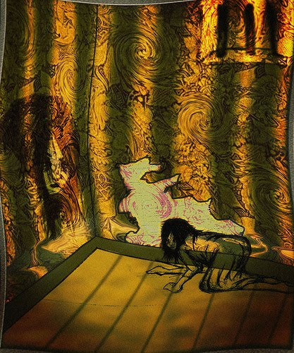
Journal
Journal
What do you think is happening in this picture? How does it make you feel?

Slide 3
Background Info
Charlotte Perkins Gilman was a famous female writer who believed in social reform and feminism
Suffered from depression and was forced to practice the “rest cure”
Wrote “The Yellow Wallpaper” to protest use of the “rest cure”

Slide 4
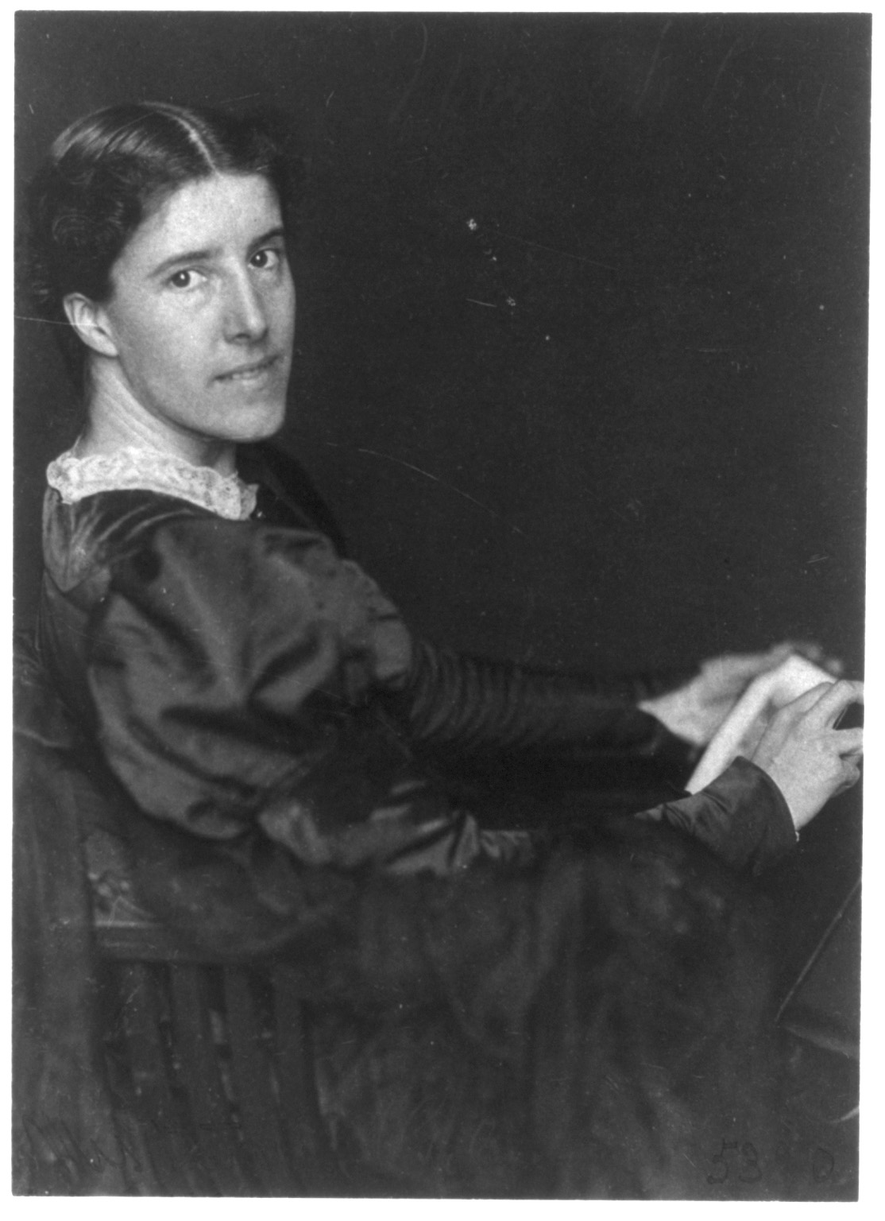

Slide 5
Terms to Know
1st person POV- story told from narrator’s perspective using pronouns like “I” and “we”
2nd person POV- story told from the perspective of “you,” putting the reading into the story
3rd person limited POV- story told from the perspective of a narrator with access to a particular character’s thoughts/feelings with pronouns like “he,” “she,” and “they”
3rd person omniscient POV- story told from the perspective of an all-knowing narrator with pronouns like “he,” “she,” and “they”

Slide 6
Terms to Know Cont.
Reliable narrator- a character whose telling of the story is considered trustworthy
Unreliable narrator- a character whose telling of the story is not completely accurate or credible due to problems with the character's mental state or maturity

Slide 7
ABC Boxes
As we read, complete the ABC graphic organizer.
For each box, you will find a word or idea from the text that begins with that letter.
If you cannot find one, you can pick a word starting with the letter that describes an aspect of the story.

Slide 8
Creeping
What do you imagine when the narrator says she is “creeping”?
https://www.youtube.com/watch?v=gWJ4ZtLlRvE&list=PL9C07B387A37B9EEC&index=8

Slide 9
Vocabulary
Flamboyant
P. 801, line 71
Lurid
P. 801, line 78
Recurrent
P. 803, line 134
Fatuity
P. 805, line 203
Undulating
P. 807, line 260
Temperament
P. 807, line 288
Convolution
P. 808, line 303
Misconstrued
P. 813, line 471
In your notebook:
Write down each word and its definition. You can use the textbook, your phone or a dictionary.
Find the word in the story and write down the sentence it’s in.
Write your own sentence using the word!

