Slide 1
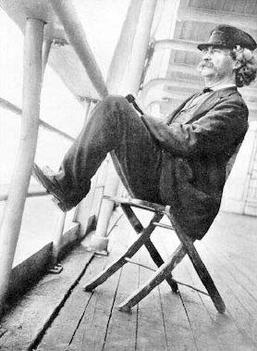
Unit 4: Regionalism and Naturalism
1870-1910

Slide 2
Journal
In your notebook, answer the following question:
What do you think the United States was like in the years following the Civil War? Think about the possible lives of different groups: Southerners, Northerners, veterans, former slaves, immigrants, etc. How do these people feel about life in the United States?

Slide 3
Note Activity
After the pre-test, you will travel around the room to find the answer for the blanks on your notes.
You must fill ALL blanks.
If you have any questions, please write them down in your notes. We will briefly go over the notes and answer questions.

Slide 4
Biography Poster Activity
Pair up.
Each pair will get a slip of paper with a name and picture of a famous person from this time period.
You may use your phone or a computer to research this person.
There are markers, glue, scissors, and construction paper for you to use.
Each poster must contain:
Name
Picture
Life dates (birth and death years)
Hometown
Occupation (job)
What they are known for
1 interesting fact
Quote
Please be neat and creative!

Slide 5
Famous People List:
John Phillip Sousa
James A. Bland
Alexander Graham Bell
Stephen Crane
Bret Harte
Willa Cather
Mark Twain
Thomas Edison
Booker T. Washington
Jack London
Kate Chopin
Charlotte Perkins Gilman
Susan B. Anthony
John D. Rockefeller
Edward Hooper
Charles Darwin
James Garfield

